Slide 1
NERCOMP 2022
Microsoft EES Year 3
April 4, 2022

Slide 2
New SHI Microsoft Practice Overview & Introduction of Team
Agreement Basics
Timeline
Overview of Assignments
Product Highlights
M365 Entitlements & EES Benefits
Microsoft Support
SHI Microsoft Services – Review
01.
02.
03.
04.
05.
06.
07.
08.

Slide 3
SHI’s Enhanced Support for Your Microsoft Portfolio
In order to optimize support for our customers’ Microsoft investment, we are introducing a new, role: Microsoft Account Executive (MAE).
To facilitate the best possible outcomes, and to help you plan for important dates and activities, we’ll regularly provide critical information – keeping you updated and agile to make informed decisions around variables like:
Updates
Procurement
Management
Adoption
Specifically, our goals are to educate; to help you procure; and to facilitate maximum product adoption and management of your Microsoft licensing.
Notes:
Technology, as with all things in life, is ever-changing. And part of our job at SHI is to provide objective, authoritative expertise to elevate your IT investment – especially with something as critical, costly, and complex as your investment in Microsoft tools. Managing the processes around your Microsoft licensing and purchasing requirements is challenging, and we know that, too frequently, organizations don’t take full advantage of maximizing the value Microsoft licensing programs can bring. This role supplements your existing SHI sales team and will coordinate with your SHI Customer Account Manager to focus exclusively on your Microsoft environment – from the important details and requirements of your Volume Licensing agreement, to the usage and consumption of your Microsoft products and all other benefits.
Our programmatic initiative will enable you to realize significant, increased results from your Microsoft licensing program.

Slide 4
SHI Microsoft Team
Nate Lessmann
Cathy Mack
Nate Lessmann
Matt Williams
Mahmoud Qazait
District Sales Manager Microsoft Education East
Sr. Microsoft Licensing Executive
Microsoft Account Executive
Sr. Corp Solutions Consultant

Slide 5
Agreement
Basics

Slide 6
Nercomp Microsoft EES
Year 3
3 Year contract July 1, 2020 – June 30, 2022 – final year of agreement
3 Assignments – Determined by Microsoft in Year 1 you can move up, but not down.
M365 A3
M365 A3 + Microsoft Defender for O365
M365 A5
You can reduce EQU counts for Online Services products ONLY

Slide 7
Understanding User Profiles for EES
What is an “EQU”?
Education Qualified User
An employee or contractor (non-student) who access or uses one of the educational platform products
Education Platform Products
Microsoft 365 A3 and Microsoft 365 A5
EMS A3 and EMS A5
Office 365 A3 and Office 365 A5
M365 Apps for Enterprise
Windows 10 Education A3 and Windows 10 Education A5
What is a Light User
Any other employee who doesn’t need the educational platform products.
Janitors, Groundskeepers, Cafeteria, etc.
What is a Student
A person who is enrolled at the school full or part time.

Slide 8
Timeline

Slide 9
2022 Anniversary
Timeline
April 18th – Quote from SHI
April 18th – May 2^{nd _} Finalize discussions around your needs and confirm contacts.
May 20th – Final quote from SHI
June 3rd – Purchase Order MUST be at SHI.
July – SHI Invoice is due.

Slide 10
Assignments

Slide 11
M365 A3 Assignment
License ALL EQU get Student Licenses at NO COST
Minimum Purchase Requirements
M365 A3
Enterprise Server Platform
Azure Monetary Commitment
M365 A3 Student Use Benefit
Office 365 EDU A1
M365Apps for device
Special Use rights for Subscribers include Multi-Language Rights, Upgrade/Downgrade Rights, Product Evaluation Rights, Productivity Server Licenses and CALS for Exchange, SharePoint and Skype for Business. Windows Server CALS. System Center Configuration Manager and System Center EndPoint Protection.
Perpetual Use Rights for Students and Home Use Program are not applicable in M365.
M365 A3
Office 365 A3
Office Pro Plus - Desktop versions of Office on up to 5 PCs or Macs, 5 tablets and 5 phones per user
Exchange - 100 GB Storage, EOP, EOA, DLP, Legal Hold and e-discovery
OneDrive - 1 TB of Storage
SharePoint
Microsoft Teams - Skype for Business
Skype for Meeting Broadcast
Additional Services: Sway, Forms , Stream, Flow, Power Apps, School Data Sync, Booking & Yammer
Delve & My Analytics
Office 365 Advanced Security Management
Windows 10 A3
Windows 10 Upgrade License Education Edition, Enterprise, Enterprise LTSB & Pro
Windows Defender Antivirus - Device Guard, Credential Guard, Exploit Guard
Enterprise Mobility & Security A3
Azure Active Directory P1 - SSO, MFA, Conditional Access, Dynamic Groups
Azure Information Protection P1 - Document Classification, Tracking and Revocation
Advanced Threat Analytics - Protection from advanced targeted attacks leveraging user and entity behavioral analytics
Intune - MDM and Mobile Application Management (MAM) without the need for device enrollment
Enterprise Server Platform
Unlimited Instances for all editions of the Serer Products and External Connectors to which the Enterprise CAL provides access rights (as identified in the Product Terms), plus all editions of System Center.

Slide 12
M365 A3 + MS Defender for O365 Assignment
License ALL EQU get Student Licenses at NO COST
Minimum Purchase Requirements
M365 A3
Microsoft Defender for O365
Enterprise Server Platform
Azure Monetary Commitment
M365 A3 Student Use Benefit
Office 365 EDU A1
M365Apps for device
Special Use rights for Subscribers include Multi-Language Rights, Upgrade/Downgrade Rights, Product Evaluation Rights, Productivity Server Licenses and CALS for Exchange, SharePoint and Skype for Business. Windows Server CALS. System Center Configuration Manager and System Center EndPoint Protection.
Perpetual Use Rights for Students and Home Use Program are not applicable in M365.
M365 A3
Office 365 A3
Office Pro Plus - Desktop versions of Office on up to 5 PCs or Macs, 5 tablets and 5 phones per user
Exchange - 100 GB Storage, EOP, EOA, DLP, Legal Hold and e-discovery
OneDrive - 1 TB of Storage
SharePoint
Microsoft Teams - Skype for Business
Skype for Meeting Broadcast
Additional Services: Sway, Forms , Stream, Flow, Power Apps, School Data Sync, Booking & Yammer
Delve & My Analytics
Office 365 Advanced Security Management
Microsoft Defender for O365
Windows 10 A3
Windows 10 Upgrade License Education Edition, Enterprise, Enterprise LTSB & Pro
Windows Defender Antivirus - Device Guard, Credential Guard, Exploit Guard
Enterprise Mobility & Security A3
Azure Active Directory P1 - SSO, MFA, Conditional Access, Dynamic Groups
Azure Information Protection P1 - Document Classification, Tracking and Revocation
Advanced Threat Analytics - Protection from advanced targeted attacks leveraging user and entity behavioral analytics
Intune - MDM and Mobile Application Management (MAM) without the need for device enrollment
Enterprise Server Platform
Unlimited Instances for all editions of the Serer Products and External Connectors to which the Enterprise CAL provides access rights (as identified in the Product Terms), plus all editions of System Center.

Slide 13
M365 A5 Assignment
License ALL EQU get Student Licenses at NO COST
Minimum Purchase Requirements
M365 A5
Enterprise Server Platform
Azure Monetary Commitment
M365 A3 Student Use Benefit
Office 365 EDU A1
M365Apps for device
Special Use rights for Subscribers include Multi-Language Rights, Upgrade/Downgrade Rights, Product Evaluation Rights, Productivity Server Licenses and CALS for Exchange, SharePoint and Skype for Business. Windows Server CALS. System Center Configuration Manager and System Center EndPoint Protection.
Perpetual Use Rights for Students and Home Use Program are not applicable in M365.
M365 A5
Office 365 A5
Office 365 A3+
Customer Lock Box
Advanced e-Discovery
Advanced Data Governance
Microsoft Cloud App Security
Microsoft Defender for Office 365
Office 365 Threat Intelligence
M365 Information Protection & Governance
M365 eDiscovery & Audit
M365 Insider Risk Management
Audio Conferencing
Phone System
Windows 10 A5
Windows 10 Upgrade License Education Edition, Enterprise, Enterprise LTSB & Pro
Windows Defender Antivirus - Device Guard, Credential Guard, Exploit Guard
Microsoft Defender for Endpoints
Enterprise Mobility & Security A5
Azure Active Directory P2 – Identity and access management with advanced protection for users and privileged identities
Azure Information Protection P2 – P1 plus, Document Classification, Tracking and Revocation
Azure Information Protection P2 - P1 plus, automated classification and hold your own key
Microsoft Cloud App Security - Enterprise-grade visibility, control, and protection for your cloud applications
Microsoft Defender for Identity- Detect and investigate advanced attacks and suspicious behaviors on-premises and in the cloud
Enterprise Server Platform
Unlimited Instances for all editions of the Serer Products and External Connectors to which the Enterprise CAL provides access rights (as identified in the Product Terms), plus all editions of System Center.

Slide 14
M365 A5
Adds…
Telephony
Phone System
Audio Conferencing
Analytics
Power BI Pro
Security
Identity & Access Management
Threat Protection
Compliance
Azure Information Protection Plan 2
Customer Key for O365
Information Protection & Governance
eDiscovery & Auditing
Insider Risk Management
Nercomp Cost $115.30
Notes:
Ways to Save …
Many of the components of M365 A5 are offered as standalone products or alternative bundled services. Depending on the product you can choose to buy as many or as few as you need. In many case if you choose to license your full EQU you can license Students at no cost. Alternative bundles like O365 A5 allow you to get the telephony and analytics without the Security and Compliance offers or maybe you’re not interested in the telephony but need the Compliance or Security components there are options for those as well which we will review on the next slide.

Slide 15
M365 Add On
Compliance and Security Packages
M365 A5 Compliance
$33.00 Per User Per Year
Azure Information Protection Plan 2
Customer Key for O365
M365 A5 Information Protection & Governance
Cloud & Communication Data Loss Prevention
Records Management
Machine Learning based auto classification
Customer Key
Advanced Message Encryption
M365 A5 Insider Risk Management
Communication Compliance
Information Barriers
Customer Lockbox
M365 A5 eDiscovery & Audit
Investigation and eDiscovery solutions for IT & Legal
One-Year Retention of Audit Logs
M365 A5 Security
$35.30 Per User Per Year
Microsoft Defender for O365 Plan 2 - Defender for O365 + Threat Intelligence
Protects against sophisticated attacks like phishing and zero-day malware
Microsoft Defender for Cloud Apps
Is a Cloud Access Security Broker solution
Microsoft Defender for Identity
Protects enterprise hybrid environments from advanced targeted cyber-attacks and insider threats
Azure Active Directory Plan 2
Identity Protection – risk based conditional access
Privileged Identity Management – just in time access
Microsoft Defender for Endpoints
Risk based vulnerability management and assessment
Attack surface reduction capabilities
Behavioral based and cloud-powered next gen protection
Notes:
AIP Premium Plan P2 subscriptions :
Automatic and recommended classification for certain types of data that meet certain conditions to apply protections rather than relying solely on manual labeling.
Automatic use of the Secure/Multipurpose Internet Mail Extensions (S/MIME) protocol to sign and encrypt messages in Outlook.
Added information protection in Outlook that detects the potential sharing of sensitive information.
Hold Your Own Key (HYOK) functionality for users in regulated environments for confidential data that cannot leave the internal network.
Automatic protection, classification and labeling for on-premises files.
Customer Key helps you meet compliance obligations because you control the encryption keys that Microsoft 365 uses to encrypt and decrypt data.
Information Governance helps organizations manage their risk through discovering, classifying, labeling, and governing their data.
Insider risk management is a solution in Microsoft 365 that helps minimize internal risks by letting you detect, investigate, and take action on risky activities in your organization.
eDiscovery provides investigation and eDiscovery solutions for IT and legal departments within corporations to identify, collect, preserve, reduce, and review content related to an investigation or litigation prior to export out of the Microsoft 365 system.
Advanced Audit in Microsoft 365 provides one-year retention of audit logs for user and admin activities and provides the ability to create custom audit log retention policies to manage audit log retention for other Microsoft 365 services. It also provides access to crucial events for investigations and high-bandwidth access to the Office 365 Management Activity API. For more information, see Advanced Audit in Microsoft 365.

Slide 16
Product Highlights

Slide 17
Microsoft Power Platform
Notes:
Microsoft Power Platform Empowers everyone at your organization with an intuitive, collaborative, and extensible platform of low-code tools that makes it easy to create efficient and flexible solutions.

Slide 18
What is Power BI?
Licensing Power BI
Power Bi Desktop
Free download to create Power BI content
Power BI Free
Use of Power BU service to connect to data and create reports and dashboard
Can’t share content with other people
Power BI Pro
$ 24.50 per user per year
Included in Office 365 A5 and Microsoft 365 A5
Required for all users who share content
Required for all users who consume shared content, apart from content published to the web, or printed content
Power BI Premium per User
$51.50 per user per year
Includes all the features of Pro licenses along with capabilities only available in Premium
Power BI Report Server
Power BI Pro licenses required for content publishers
Use rights for customers with active SA on SQL ENT Core licenses
How do I license it?
Create amazing data experiences - Easily connect to, model, and visualize your data, creating memorable reports personalized with your KPIs and brand.
Gain insight from your largest BI deployments - Make the most of your big data investments by connecting to all your data sources with the scale to analyze, share, and promote insights across your organization while maintaining data accuracy, consistency, and security.
Make decisions with confidence - Work together easily on the same data, collaborate on reports, and share insights across popular Microsoft Office applications such as Microsoft Teams and Excel—empowering everyone in your organization to quickly make data-driven decisions that drive strategic actions.
Notes:
Power BI is a collection of software services, apps, and connectors that work together to turn your unrelated sources of data into coherent, visually immersive, and interactive insights. Your data may be an Excel spreadsheet, or a collection of cloud-based and on-premises hybrid data warehouses. Power BI lets you easily connect to your data sources, visualize and discover what's important, and share that with anyone or everyone you want. Connect to and visualize any data using the unified, scalable platform for self-service and enterprise business intelligence (BI) that’s easy to use and helps you gain deeper data insight.

Slide 19
What are Powers Apps?
Power Apps per User
$ 50.40 per user per year
A single license enables a user to access any number of apps and portal across any environments
Licenses are assigned to the user via the Microsoft 365 Admin Center
Best for businesses that want one license for each user, regardless of the number of apps the need to run.
Power Apps per App
$ 100.80 per user per year
A single license enables a user to access 2 apps and 1 portal within an environment
Licenses are assigned to one environment via the Power Platform Admin Center
Licenses are allocated to users when an app in an environment is shared with a user
Best for businesses that want to license each user for a single app, the flexibility to stack licenses for additional apps
How are Power Apps licensed?
Power Apps picks up where other solutions fall short
Some Solutions are best solved by off-the-shelf SaaS Solutions
But there isn’t always “an app for that.”
Some processes are best solved by traditional custom development an organization can invest in.
But there is only so much traditional custom app development an organization can invest in.
Everything else is a missed opportunity to optimize and innovate.
The Power Apps low-code development platform solves this for you.

Slide 20
What is Power Automate?
Power Automate per User
$75.60 per user per year
A single license enables a user to access any number of flows across any environments
Licenses are assigned to users via the Microsoft 365 Admin Center
Best for businesses that want one license for each user, regardless of the number of flows they need to run
Power Automate per Flow
$ 504.00 per user per year
A single license enables unlimited users to access a flow across an organization
Licenses are assigned to one flow via the Power Platform Admin Center
Minimum purchase of 5 licenses
Best for businesses that want to implement flows for unlimited users across an organization
How is Power Automate licensed?
Power Automate is a service that helps you create workflows between your favorite apps and services to synchronize files, get notifications, collect data and more.
Here are a few examples of what you can do with Power Automate.
Automate business processes
Send automatic reminders for past due tasks
Move business data between systems on a schedule
Connect to more than 500 data sources or any publicly available API
You can even automate tasks on your local computer like computing data in Excel.

Slide 21
Robotic Process Automation
Automates legacy applications by users recording a series of steps for the automation technology to then perform as a process

Slide 22
Licensing RPA
Power Automate per User with Attended RPA
$ 252.00 per user per year
Includes the full capabilities of the Power Automate per User plan
Includes desktop flow creation capabilities
The desktop flow must run on the same workstation as the user is using
Multiple desktop flows must be run sequentially
Triggered by an explicit user action on their workstation
Power Automate Unattended RPA add-on
$ 945.00 per bot per year
Qualifying base licenses
Power Automate per User with Attended RPA
Power Automate per Flow
Triggered in the background

Slide 23
Career Coach
Discover Career Paths
Explore career options that match their interest
Find inspiration
Connect with Alumni
Grow real-world skills
Connect students with different learning experiences
Track progress as they gain real-world skills necessary to pursue their career goals
Build Professional Networks
Students can build meaningful connections with Alumni, Peers, and Faculty and get support along their career journey.
Career Coach and LinkedIn Learning
Career Coach features certain LinkedIn Learning courses that offer specific career-related guidance and activities within the app at no additional charge. With a separate LinkedIn Learning campus subscription, access to full 16,000+ course library is seamlessly integrated into the experience for continued growth in all skills used in today’s job market.
Give students the power to explore, learn, and network in Teams.
$12.00 per user per year
Notes:
Your institution can stand out by improving student success and driving student employment outcomes using the combined power of Career Coach and LinkedIn.
Improve student success to drive employment outcomes -
Career Coach gives institutions a comprehensive solution focused on career planning, real-world skills, and networking to help students discover opportunities that match their aspirations.
Gain valuable insights to enhance student experience - Increase insight into student skills and career goals so you can support student engagement, while optimizing curriculum to align with the job market.
Customize with your unique institution offerings- Tailor the Career Coach app to integrate your institution’s unique courses, programs, services, and brand.

Slide 24
Microsoft Viva
Offer employees personal insights and recommendations
to prioritize wellbeing and boost productivity.
Foster a culture where people Thrive
Empower managers to foster productivity and wellbeing for teams—large or small. Help managers proactively drive a healthy team culture and improve team effectiveness.
Microsoft Viva is an employee experience platform that brings together communications, knowledge, learning, resources, and insights in the flow of work.
Powered by Microsoft 365 and experienced through Microsoft Teams, Viva fosters a culture that empowers people and teams to be their best from anywhere.
Empower leaders with insights that identify opportunities to improve wellbeing and engagement.
Prices vary please reach out to set up a call to review the offerings.
Notes:
Streamline learning and development
Viva Learning brings learning into the flow of work to promote a culture of growth and development.
Accelerate learning
Viva helps employees make learning a natural part of the day by bringing learning into the flow of work with the tools they already use.
Balance productivity and wellbeing
Viva helps people and business thrive with recommendations to improve productivity and wellbeing.
Put knowledge and expertise to work
Viva Topics helps employees put knowledge to work with the help of AI in the apps they use every day. Viva Topics automatically organizes content across apps and teams with built-in security and compliance features.
Rally and motivate your employees
Viva Connections helps promote communication across the workplace, all from one central location.

Slide 25
M365 Entitlements & EES Benefits

Slide 26
Microsoft 365 Education A3/A5 are the successors to the Education Desktop and give equivalent and enhanced rights:
EES Special Use Rights for M365 Education A3/A5
Desktop Rights
Enterprise CAL Suite Rights
Server Installation Rights
Rights to install Office Professional Plus 2016 on a single device per licensed user
Rights to downgrade this installation of Office Professional Plus
Rights to downgrade to Windows 8.1 Enterprise/Pro or earlier versions, or Windows 11 Pro Education, or Windows 11 Enterprise LTSB
Exchange Server, SharePoint Server, Skype for Business Server Standard and Enterprise CALs
Windows Server and Windows Server ADRMS CALs
Advanced Threat Analytics CML
System Center Configuration Manager CML
System Center Endpoint protection SL
Rights to install current or previous versions of Exchange Server, SharePoint Server, Skype for Business Server on as many servers as required, dedicated to the customer, in physical or virtual infrastructures

Slide 27
Customer may acquire student use benefit by purchasing the Product via a suite/bundle or as Standalone If customer purchases a suite/bundle containing a Qualifying product, they receive SUB only for the individual product, not for the entire suite/bundle If a Qualifying product is purchased via a suite/bundle the education qualified user : student ratio is 1:40, if the Qualifying product is purchased Standalone the education qualified user : student ratio is 1:15
What is the Student Use Benefit?
Customer Benefits
Easy, convenient | Cost Effective | Way to license student owned and institution owned devices

Slide 28
Microsoft Imagine Academy
Benefit
Effective November 1st, 2020, Microsoft Imagine Academy Program (MSIA) is available to all Microsoft School, Campus 3, or Open Value volume license agreement as a program skills benefit at no additional cost. MSIA provides comprehensive resources and exclusive discounts to enable innovative education.
The MSIA benefit provides the following resources to help Educators prepare to pass Microsoft certification exams and earn Microsoft certification credentials:
30 certification exam vouchers per Microsoft School, Campus 3, or Open Value volume license agreement, each of which can be redeemed to take one Microsoft certification exam:
Microsoft Office Specialist (MOS)
Microsoft Technology Associate (MTA)
Microsoft Fundamentals
Microsoft Certified Educator (MCE)
Professional development guides are available through the MSIA member site
Microsoft Certified Educator certification study guides and exam preparation help Educators demonstrate competency integrating technology into teaching and learning
Access to curriculum for professional development including the Microsoft Educator Community online professional development courses

Slide 29
Azure Dev Tools for Teaching
The new Azure Dev Tools
Microsoft announced Feb 13, 2019
New Subscription benefits
Manage and access software through a centralized online location that eliminates the need to maintain a web store or an internal site.
Provide your academic users with access to software and the Azure cloud platform through one online portal. Verified students can also get free access to Azure without a credit card, plus USD100 in credit. Limited to STEM Departments.
Give your academic users one-stop access to additional training and learning materials via Microsoft Learn.
FAQ

Slide 30
Monthly Azure Credit
For Visual Studio Subscribers
BENEFITS
Credit for us on a wide range of Azure services – Virtual Machines, Storage, SQL Databases, Containers, Cognitive Services, Functions, Data Lake, and much more.
Azure dev/test pricing helps your credit last longer.
Exclusive access to Windows 10 virtual machine
Easy-sign-up. No credit card required.
No surprises. A spending limit protects you from overage charges. You can remove the spending limit when you're ready.

Slide 31
Microsoft Support
Contact Information

Slide 32
Microsoft VLSC and Visual Studio Support
Microsoft Volume Licensing Service Center (VLSC) - is an online platform made to make managing your Microsoft Volume Licensing agreements simple. Within VLSC, you can access your licensing information, view agreements and purchases for your campus, and access licensing summaries of all entitlements by product and versions, as well as view all assigned product keys and download products from the VLSC.
Support #: 1-866-230-0560 | 5AM - 5PM PST Monday thru Friday
Option 1 - Software Installation/Technical Support
Option 2 - Activate Microsoft Product)
Option 3 - Sales Information related to Purchasing or licensing Microsoft Products
Option 4 - All other inquiries
Support Web Form: VLSC - Volume Licensing Support Request
Microsoft VLSC Training & Resources
How to Videos
How to Use the VLSC
Managing Software Assurance Benefits
Managing Permissions (VLSC)
Downloads and Keys (VLSC)
Visual Studio Subscriptions & Azure Devs Ops for Teaching
Outside of SHI Scope and need to submit a ticket via below Microsoft Process
Visual Studio Support # (US): 1-800-759-5474
Option 1: Volume Licenses Administrator or need support to manage subscriptions and downloads on a volume contract
Option 2: Activate, Purchasing, Benefit Inquires, Sign-In or Cloud Assignment
Option 3: Changes to your Subscription Info, Cancelation, Download and Software Errors
Option 4: Technical Support Incident using your subscription benefits
Option 5: All Other Inquiries
Visual Studio: https://visualstudio.microsoft.com/subscriptions/support/
Azure Dev Ops for Teaching: https://azure.microsoft.com/en-us/education/institutions/dev-tools-for-teaching-faq/
Support Ticket: Visual Studio or Azure Dev Ops for Teaching Web Form

Slide 33
Microsoft Cloud Portal Support
O365 Portal
SHI does not provide technical support for this portal. Customer must submit a ticket with O365 Support
Microsoft O365 Support Articles
O365 Support # (US): 1-800-865-9408 | Billing Hours Mon-Fri 9AM to 5PM | Technical Support (English) 24 hours a day, 7 Days a Week
O355 Support: O365 Support Web Form
Select the Need Help? Button
In the Need Help? pane enter what you need help with, and press Enter
If the results don't help, select Contact Support
Enter a description of your issue, confirm your contact number and email address, select your preferred contact method and then select Contact Me. The expected wait time is indicated in the Help Need? pane.
O365 Support #: 1-877-913-2707 | Follow the options for Education Plans
Option 1 - Enterprise, Business, Education or Non-Profit Plan
Option 1 - Technical Support
Option 2 - Billing, Subscriptions or Activation
Option 3 - Purchase Microsoft Services for Business Use
Option 4 - Cancel a Subscription
Hold for a direct Microsoft O365 Support Representative to direct your call
O365 Online Services Activation Email:
Contact VLSC at 1-866-230-0560; Option 4; Option 2
Azure Portal
Outside of SHI Scope and need to submit a ticket with Azure Support
Azure Support: Azure Support Web Form
Enter a support ticket filling out the required information
If you need a walk-thru of the Azure EA Portal
Choose the type: Enterprise Portal
Choose the category: Scheduling an Onboarding or Concierge Session
After this Azure Support will conduct an on-boarding call with your campus
Other Helpful Support items for Azure
Microsoft Azure Enterprise Portal - To view your enterprise level accounts, subscriptions, monetary commitment and overage balances and to create accounts and subscriptions
Microsoft Azure Portal - To deploy and host your applications once you have created a subscription on the Microsoft Azure Enterprise Portal
Demos of the various roles, portals and features can be found on our Enterprise Azure YouTube Channel

Slide 34
Cloud Optimization

Slide 35
Technology Strength | Ranking
Cloud Optimization - FinOps
Storage Technologies
Backup Technologies
Hyper Converged Technologies
Networking
Mahmoud Qazait
Cloud Optimization Consultant
5 Years at SHI

Slide 36
Why do Companies Overspend?
Lack of validation from impartial third party (TCO/Rationalization)
Paying double for licensing
Pure waste = Sprawl gets out of control
Not maximizing commitment discounts
Infrastructure not designed for cloud
Complexity
Reserved Virtual Machines
Volume Discounts

Slide 37
Governance for Cost Optimization
Step 1 - Define “Good”
Step 2 - Awareness & Alerts
Step 3 – Automation/Remediation
Tagging Strategy
Retention/Lifecycle Policy
Automate cleanup of waste
Awareness of Waste
Performance Criteria
Alerting/Reporting
CloudHealth Perspectives or Cost Allocation Tags
Proactive purchase and exchanging of reservations
Account Structure
Marketplace Usage vs BYOL
Automating termination of resources
Business Units, Owner, PROD vs Dev, Application
RI/SP Purchase Criteria/Budget
Accountable Parties
Scheduling Auto Start/Stop
Implementing a lifecycle
Workflow for implementation of action plan with accountability defined
Untagged Resources

Slide 38
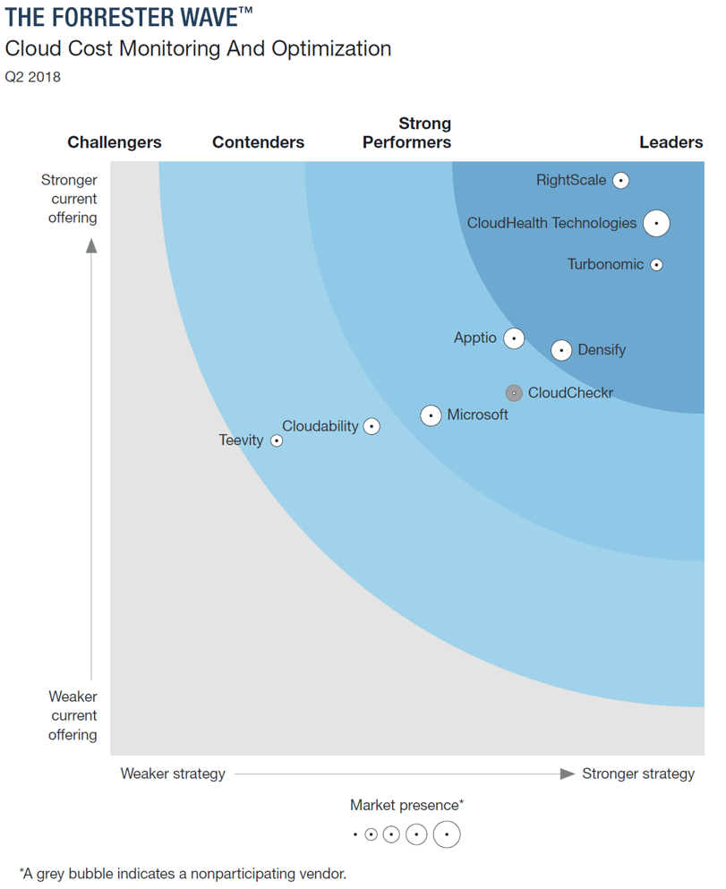
Tools
We leverage the CloudHealth Platform
Powerful Policy Management
Direct Integration to Cloud Platforms
AWS
GCP
Azure
CloudHealth provides:
CloudHealth Monitoring Agent
Cloud Governance Checks
Cloud Risk Exposure Checks
Detailed reporting
Integration with other 3rd party tools

Slide 39
Reporting

Slide 40
Policy Creation

Slide 41
Optimize
Helping you save 30%-50% on your cloud bill every month

Slide 42
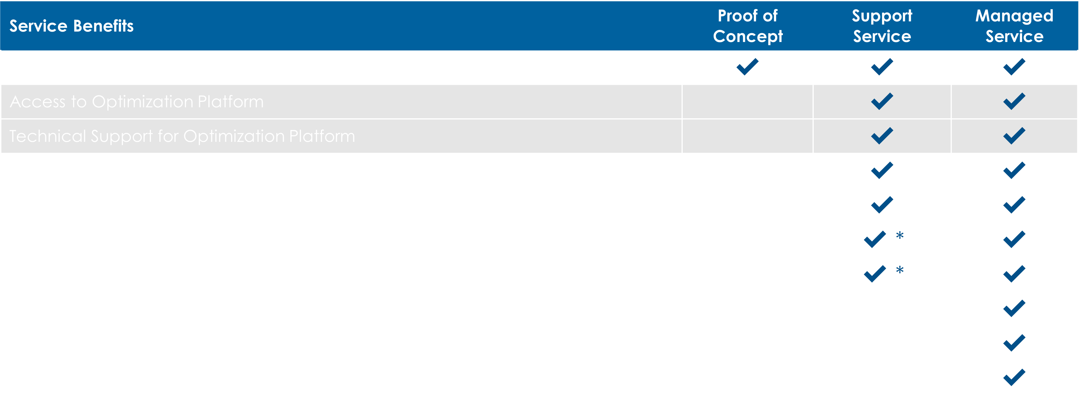
Optimize
Helping you save 30-50% on your cloud bill every month
SHI offers a selection of cloud optimization services ranging from a high-level summary of potential savings to a managed service.

Slide 43
Summary Page

Slide 44
Optimization
POC

Slide 45
Notes:
To add your own hyperlinks, select desired icon and click ‘insert’ from the main menu bar and look for ‘hyperlink’ in the drop-down menu.
Please delete any unused icons.

